Slide 1
Stack overflow
Vinay lakamsani

Slide 2
Company goal
Make leader board more interesting
Showcase efforts of active users
Regular users to contribute more

Slide 3
Did new users put more effort?
Regular users might attract more users
Regular users put more effort -> so that more regular users show up
Regular users might put in more effort the week after they show up on the weekly leader board

Slide 4
Goal: Impact of recognition?
Weekly leaderboard & monthly leaderboard –impact on performance
Long of impact last
Positive or negative impact
High or low quality
More risk averse

Slide 5
Goal 01 :Impact on regular users
Change date 2011 march 11
Get the people with scores and for 1 year before and after
Compare people and with there effort
Get users from march 11 2010 to march 12 2011
Get users from march 11 2011 to march 12 2012
Compare them

Slide 6
Goal 1 : objective 01
Get last week top users
Reputation formula
Reputation = new creation + answering post + Upvote – downvote
Upvote
Votetypeid 2: UpMod; is this equivalent to an upvote
Votetypeid 3: DownMod; is this equivalent to a downvote

Slide 7
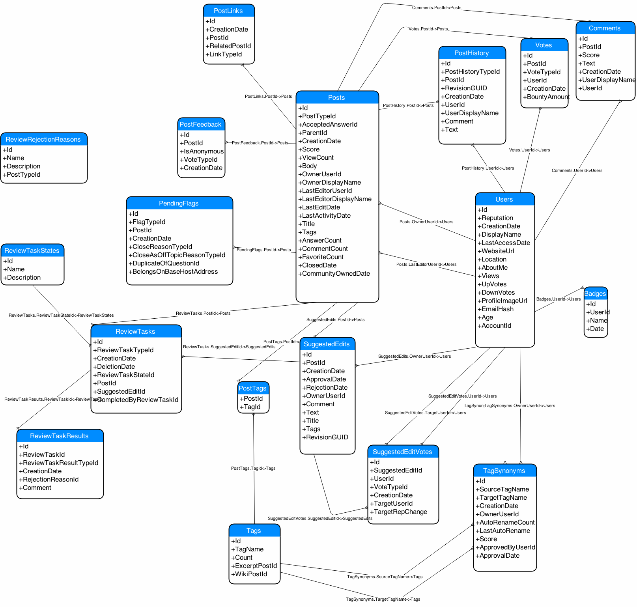

Slide 8
reputations
https://meta.stackexchange.com/questions/7237/how-does-reputation-work

Slide 9
Objective 02 : comparing the data
Comparing the week before and after
62/100 of them matching in both of them
List all changes in reputation of respective person

Slide 10
Objective 03 check impact for next 5 weeks
Get the data for all the weeks
Week1 : 2011-03-04 00:00:00 between 2011-03-11 00:00:00
Week2 : 2011-03-11 00:00:00 between 2011-03-18 00:00:00
Week3 : 2011-03-18 00:00:00 between 2011-03-25 00:00:00
Week4 : 2011-03-25 00:00:00 between 2011-04-02 00:00:00
Week5 : 2011-04-02 00:00:00 between 2011-04-08 00:00:00

Slide 11
Ids with matching for more than 2 weeks
616700 29407 34397 138475 505088 88656 23354 151292 61974 17034 50079 157882 279627 415784 165520 501557 31671 14860 115145 656769 166749 20862 573261
616700 50079 29407 501557 34397 17034 157882 505088 20862 656769 23354 138475 151292 65358 14860 415784 643977 166749 31671 103167 573261 329769 55159
151292 50079 29407 17034 616700 66674 157882 138475 505088 34397 23354 273200 656769 31671 572644 279627 87234 329769 106224 203907 23283 34509 115145

Slide 12
Conclusion for weekly toppers
Week 2& 3 common people = 70
Week 3& 4 common people = 64
Week 4 & 5 common people = 59
For week 2,3,4,5 = 34 are in common

Slide 13
Goal 2 : checking leader board position user
Reputation at the end of the all the 5 weeks

Slide 14
conclusions
Weekly leaderboard & monthly leaderboard –impact on performance
Long of impact last - > checked for 5 weeks (impact is there)
Positive or negative impact -> positive effect
High or low quality ->
More risk averse

